Slide 1
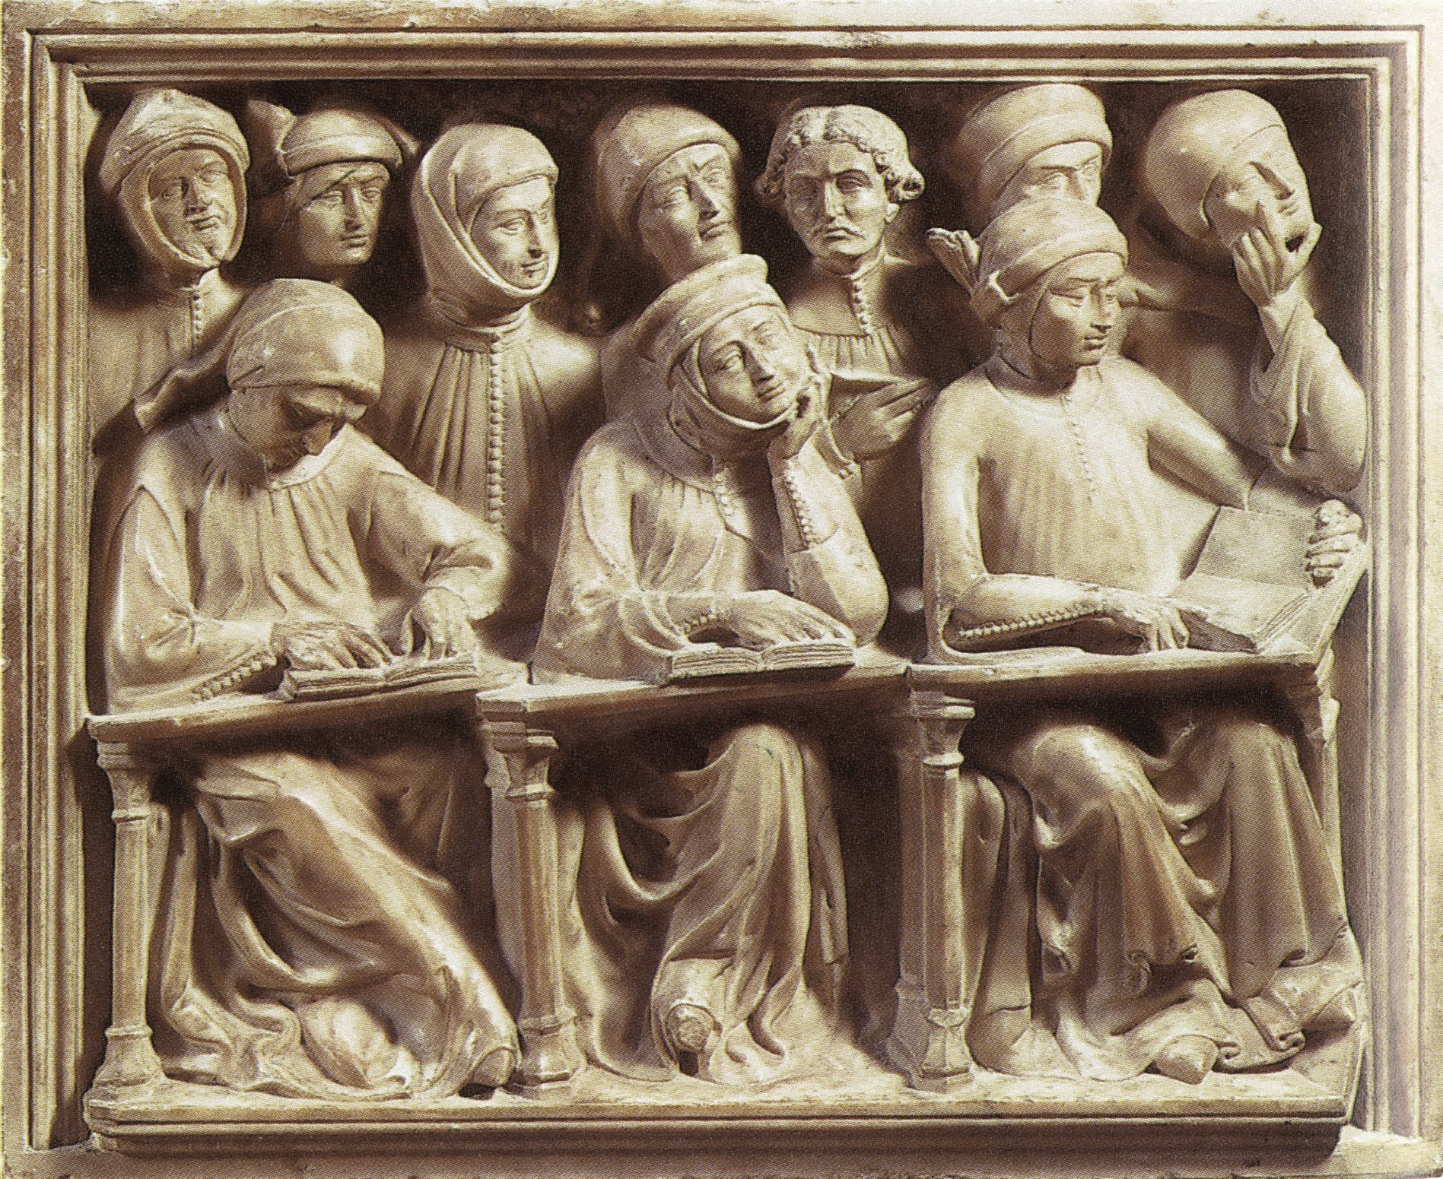
PRAXIS II – ART CONTENT
BOOTCAMP:
Studying Together for Success
Notes:
JOINT PROJECT WITH MYSELF AND DR. SUSAN WHITELAND
*Tomb Giovanni da Legano, relief of students from the University of Bologna, 1386

Slide 2
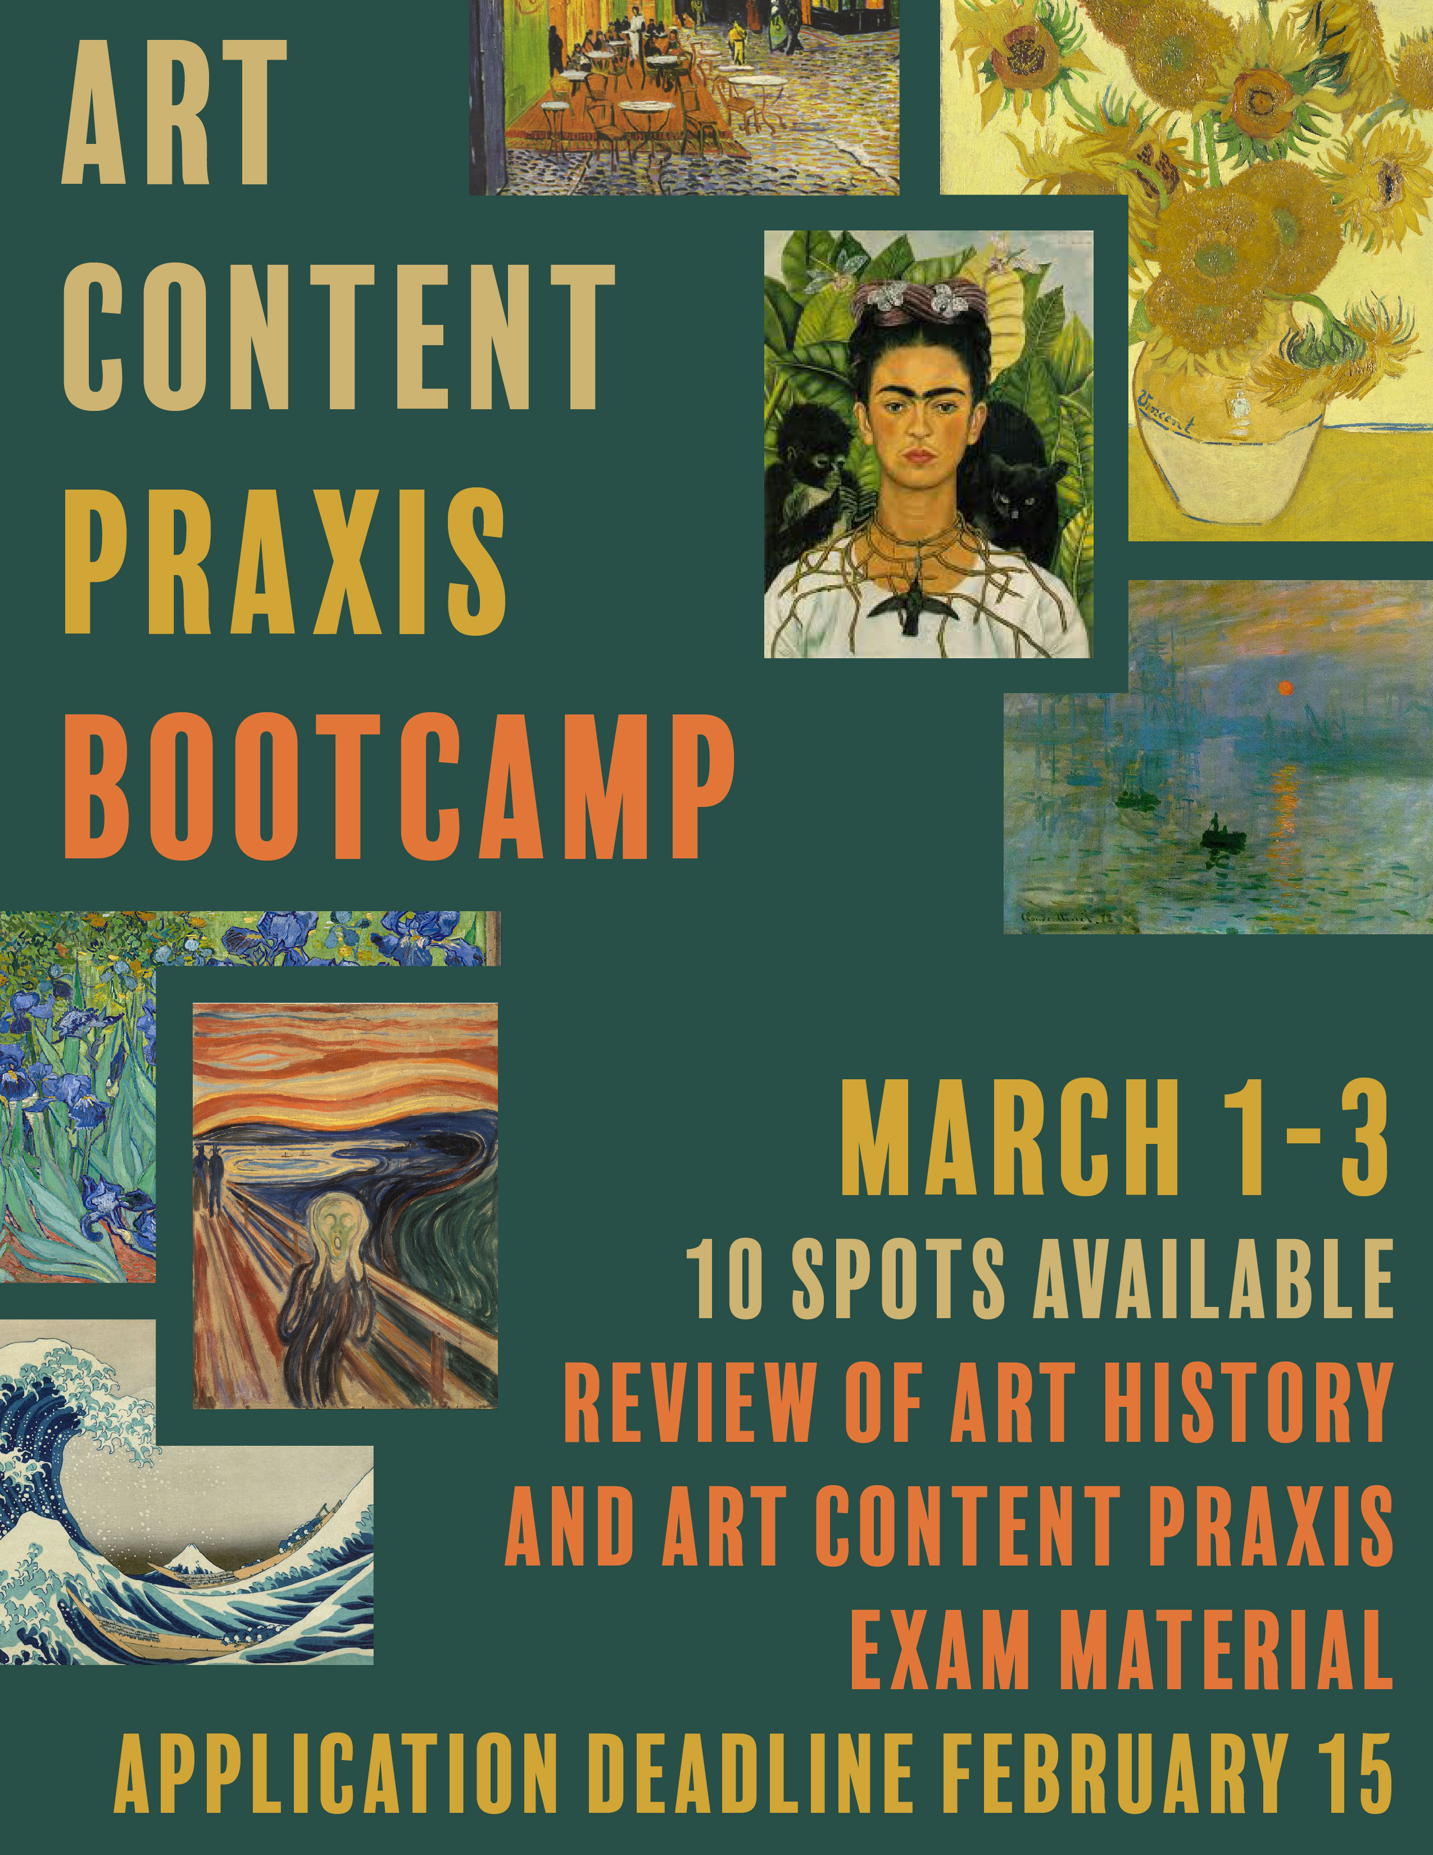
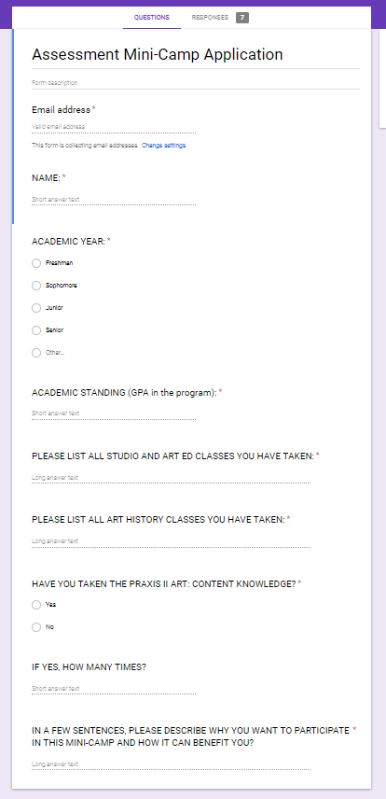
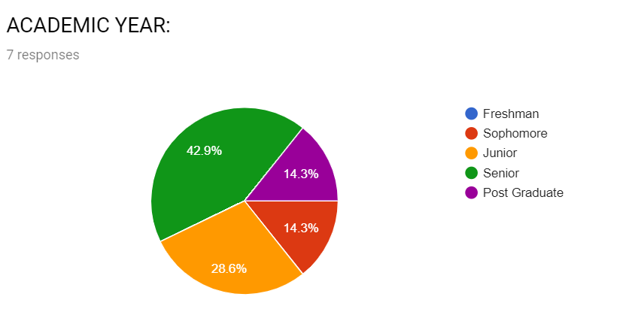
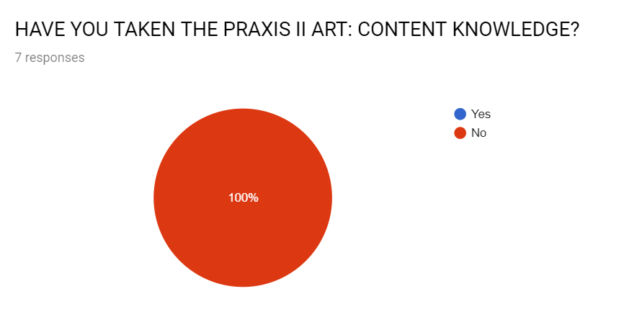
PROGRAM OBJECTIVE:
Students will work collaboratively to create study materials that will allow them to pass the Praxis II – Art Content test*
* Required for teaching Art Education
in the State of Arkansas
Notes:
ONCE THE GOAL WAS ESTABLISHED, AND THE SUPPORT OF ASSESSMENT SECURED, MOVED ONTO RECRUITMENT
POSTER CAMPAIGN AND DIRECT CONTACT
CANDIATES USED A GOOGLE FORM TO APPLY, A METHOD THAT PROVIDED US WITH MORE INFORMATION ABOUT THEIR POSITION IN THE PROGRAM
- CLASSES TAKEN SO FAR, ACADEMIC YEAR…AND WHETHER THEY HAD EVER TAKEN THE TEST
SEVEN STUDENTS WERE ACCEPTED INTO THE BOOTCAMP
- SCEHDULED TO TAKE PLACE OVER THE COURSE OF THREE DAYS IN EARLY MARCH

Slide 3
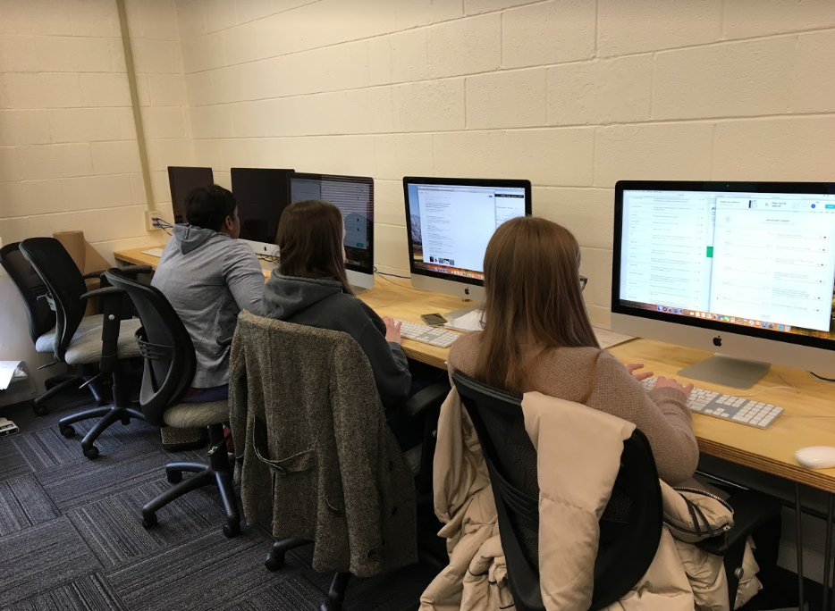
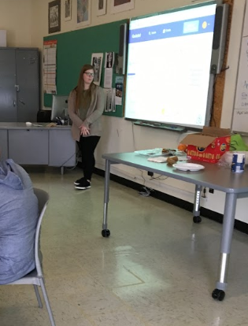
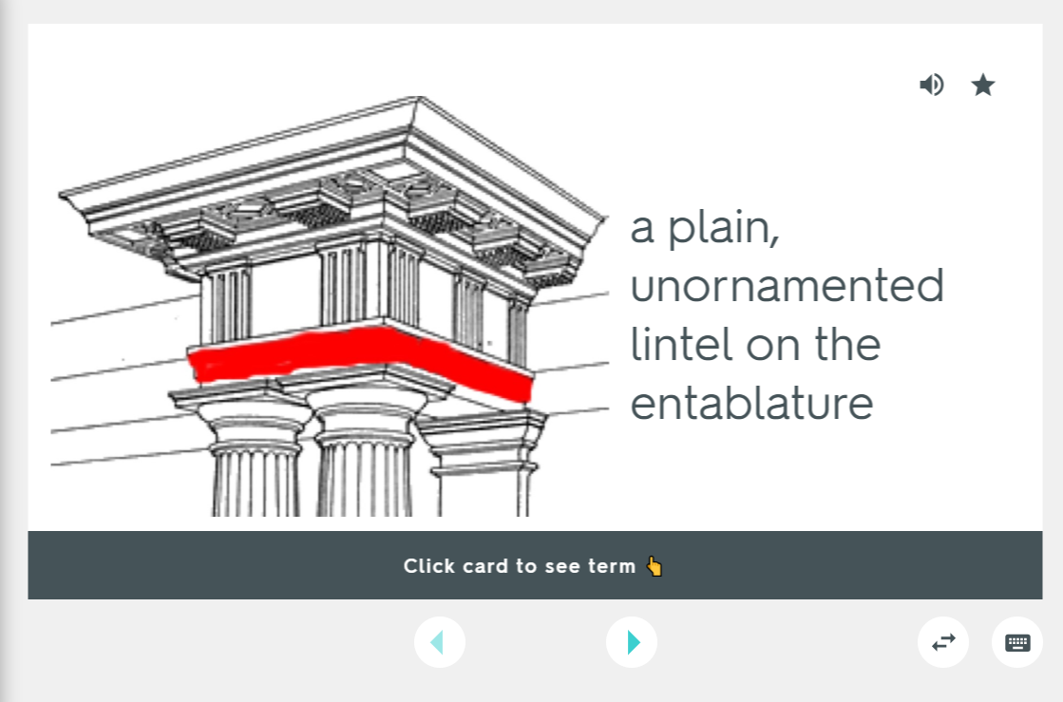
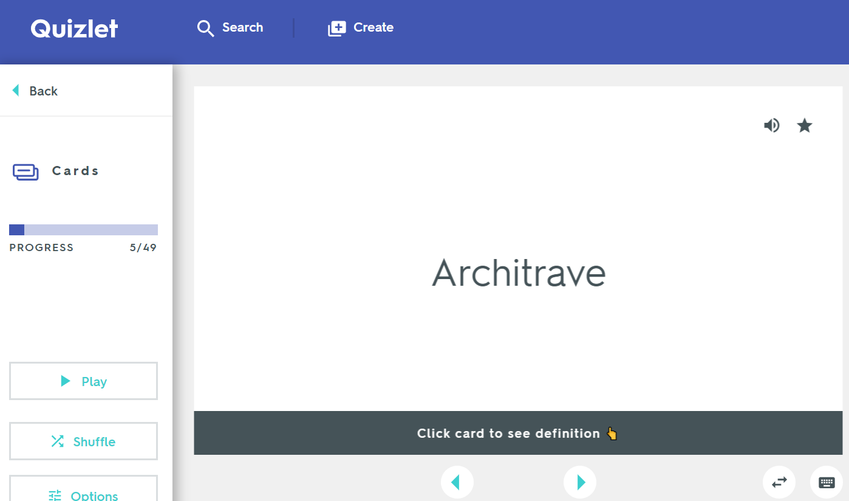
BOOT CAMP APPROACH:
Take practice test
Break into groups,
evenly dividing the subjects
3) Research topics individually,
creating flashcards using Quizlet
4) Present the material to the group
5) Take second practice test
Notes:
Detail Of Wildunger Altar, Circa 1403 by Conrad Von Soest

Slide 4
RESULTS:
I II
55 89
58 73
64 78
68 79
75 85
74 84
75 84
Practice Test Scores
(number of correct answers)
Notes:
THERE WAS IMPROVEMENT – BUT AT THIS TIME WE CANNOT BE CERTAIN THAT THE IMPACTING VARIABLE WAS THE FLASHCARDS AND COLLBORATIVE LEARNING MODEL OR THE TAKING OF THE PRACTICE TEST
COLLABORATIVE CREATED LESS ANIXETY – DIVISION AND SHARING
PROVIDED A DATABASE OF SHARED MATERIAL THAT CAN BE USED GOING FORWARD
CREATED A COMMUNITY OF STUDENTS WHO CAN STUDY WITH AND SUPPORT ONE ANOTHER GOINGIN THE FUTURE
AS AN ADENDUM: WE JUST HEARD FROM A STUDENT WHO PASSED THE PRAXIS LAST WEEK. HER METHOD WAS TO USE THE FIRST PRACTUCE TEST WE ADMINISTERED FOLLOWED BY QUIZLET FLASHCARDS TURNED INTO TESTING QUESTIONS. WHILE NOT DIRECTLY CONNECTED TO THE BOOT CAMP PER SE, IT DOES PROVIDE ADJACENT EVIDENCE THAT THIS APPROACH IS VALID AND WILL ASSIST STUDENTS IN PASSING THE PRAXIS.
Robinet Testard, “Penelope writes a letter to her husband Odysseus,” from Octavien de Saint-Gelais's translation of Ovid's Heroides, 1497

Slide 5
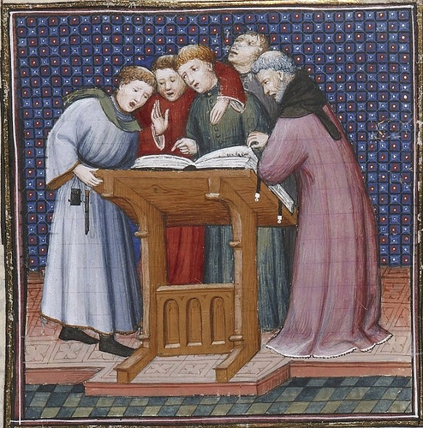
RESULTS:
Reflection
Responses
“The collaborative learning process was helpful because rather than one person trying to learn everything, dividing up and helping each other made the process much easier and less stressful. Also people who knew more in one are than another were able to explain concepts to make the rest more familiar with that concept.”
Notes:
COLLABORATIVE CREATED LESS ANIXETY – DIVISION AND SHARING
Q2: “Do you feel that creating the Quizlet flashcards during the boot camp was helpful to you as a way to prepare for the Praxis Art Content exam? Please explain your answer.”
- PROVIDED A DATABASE OF SHARED MATERIAL THAT CAN BE USED GOING FORWARD
Q3: “Do you feel that presenting your flashcards and responding to other presenters during the boot camp was helpful to you as a way to prepare for the Praxis Art Content exam? Why or why not?”
- NOT PERFECT FORMULA – MIGHT NEED TO WORK ON THE PRESENTATION ASPECT
CREATED A COMMUNITY OF STUDENTS WHO CAN STUDY WITH AND SUPPORT ONE ANOTHER GOINGIN THE FUTURE
AS AN ADENDUM: WE JUST HEARD FROM A STUDENT WHO PASSED THE PRAXIS LAST WEEK. HER METHOD WAS TO USE THE FIRST PRACTUCE TEST WE ADMINISTERED FOLLOWED BY QUIZLET FLASHCARDS TURNED INTO TESTING QUESTIONS. WHILE NOT DIRECTLY CONNECTED TO THE BOOT CAMP PER SE, IT DOES PROVIDE ADJACENT EVIDENCE THAT THIS APPROACH IS VALID AND WILL ASSIST STUDENTS IN PASSING THE PRAXIS.
Robinet Testard, “Penelope writes a letter to her husband Odysseus,” from Octavien de Saint-Gelais's translation of Ovid's Heroides, 1497

Slide 6
RESULTS:
Reflection
Responses
“The collaborative learning process was helpful because rather than one person trying to learn everything, dividing up and helping each other made the process much easier and less stressful. Also people who knew more in one are than another were able to explain concepts to make the rest more familiar with that concept.”
“Yes, I felt like this was a good process. We were able to combine all of our cards and look at them all together. The cards will last forever and will be easily assessable to us in the future.”
Notes:
COLLABORATIVE CREATED LESS ANIXETY – DIVISION AND SHARING
Q2: “Do you feel that creating the Quizlet flashcards during the boot camp was helpful to you as a way to prepare for the Praxis Art Content exam? Please explain your answer.”
- PROVIDED A DATABASE OF SHARED MATERIAL THAT CAN BE USED GOING FORWARD
Q3: “Do you feel that presenting your flashcards and responding to other presenters during the boot camp was helpful to you as a way to prepare for the Praxis Art Content exam? Why or why not?”
- NOT PERFECT FORMULA – MIGHT NEED TO WORK ON THE PRESENTATION ASPECT
CREATED A COMMUNITY OF STUDENTS WHO CAN STUDY WITH AND SUPPORT ONE ANOTHER GOINGIN THE FUTURE
AS AN ADENDUM: WE JUST HEARD FROM A STUDENT WHO PASSED THE PRAXIS LAST WEEK. HER METHOD WAS TO USE THE FIRST PRACTUCE TEST WE ADMINISTERED FOLLOWED BY QUIZLET FLASHCARDS TURNED INTO TESTING QUESTIONS. WHILE NOT DIRECTLY CONNECTED TO THE BOOT CAMP PER SE, IT DOES PROVIDE ADJACENT EVIDENCE THAT THIS APPROACH IS VALID AND WILL ASSIST STUDENTS IN PASSING THE PRAXIS.
Robinet Testard, “Penelope writes a letter to her husband Odysseus,” from Octavien de Saint-Gelais's translation of Ovid's Heroides, 1497

Slide 7
RESULTS:
Reflection
Responses
“The collaborative learning process was helpful because rather than one person trying to learn everything, dividing up and helping each other made the process much easier and less stressful. Also people who knew more in one are than another were able to explain concepts to make the rest more familiar with that concept.”
“Yes, I felt like this was a good process. We were able to combine all of our cards and look at them all together. The cards will last forever and will be easily assessable to us in the future.”
“I felt that it was helpful if the presenter explained and taught more about their cards. However, if the presenter just ran through the cards I didn't feel like it was helpful. It could get boring at times and I would zone out or not retain any information.”
Notes:
COLLABORATIVE CREATED LESS ANIXETY – DIVISION AND SHARING
Q2: “Do you feel that creating the Quizlet flashcards during the boot camp was helpful to you as a way to prepare for the Praxis Art Content exam? Please explain your answer.”
- PROVIDED A DATABASE OF SHARED MATERIAL THAT CAN BE USED GOING FORWARD
Q3: “Do you feel that presenting your flashcards and responding to other presenters during the boot camp was helpful to you as a way to prepare for the Praxis Art Content exam? Why or why not?”
- NOT PERFECT FORMULA – MIGHT NEED TO WORK ON THE PRESENTATION ASPECT
CREATED A COMMUNITY OF STUDENTS WHO CAN STUDY WITH AND SUPPORT ONE ANOTHER GOINGIN THE FUTURE
AS AN ADENDUM: WE JUST HEARD FROM A STUDENT WHO PASSED THE PRAXIS LAST WEEK. HER METHOD WAS TO USE THE FIRST PRACTUCE TEST WE ADMINISTERED FOLLOWED BY QUIZLET FLASHCARDS TURNED INTO TESTING QUESTIONS. WHILE NOT DIRECTLY CONNECTED TO THE BOOT CAMP PER SE, IT DOES PROVIDE ADJACENT EVIDENCE THAT THIS APPROACH IS VALID AND WILL ASSIST STUDENTS IN PASSING THE PRAXIS.
Robinet Testard, “Penelope writes a letter to her husband Odysseus,” from Octavien de Saint-Gelais's translation of Ovid's Heroides, 1497

Slide 8
RESULTS:
Reflection
Responses
“The collaborative learning process was helpful because rather than one person trying to learn everything, dividing up and helping each other made the process much easier and less stressful. Also people who knew more in one are than another were able to explain concepts to make the rest more familiar with that concept.”
“Yes, I felt like this was a good process. We were able to combine all of our cards and look at them all together. The cards will last forever and will be easily assessable to us in the future.”
“I felt that it was helpful if the presenter explained and taught more about their cards. However, if the presenter just ran through the cards I didn't feel like it was helpful. It could get boring at times and I would zone out or not retain any information.”
“We spent 8am-6pm on art making and 8am-7:30pm on art history. I felt very tired the last couple of hours….I feel that we covered all of the necessary content, excluding safety and hazardous materials. I also feel that we did the best method of studying by using quiz-let but maybe we could walk around the art classes to look at the machines and materials in the rooms that we have. Being able to see and feel things really helps me learn”
Notes:
COLLABORATIVE CREATED LESS ANIXETY – DIVISION AND SHARING
Q2: “Do you feel that creating the Quizlet flashcards during the boot camp was helpful to you as a way to prepare for the Praxis Art Content exam? Please explain your answer.”
- PROVIDED A DATABASE OF SHARED MATERIAL THAT CAN BE USED GOING FORWARD
Q3: “Do you feel that presenting your flashcards and responding to other presenters during the boot camp was helpful to you as a way to prepare for the Praxis Art Content exam? Why or why not?”
- NOT PERFECT FORMULA – MIGHT NEED TO WORK ON THE PRESENTATION ASPECT
CREATED A COMMUNITY OF STUDENTS WHO CAN STUDY WITH AND SUPPORT ONE ANOTHER GOINGIN THE FUTURE
AS AN ADENDUM: WE JUST HEARD FROM A STUDENT WHO PASSED THE PRAXIS LAST WEEK. HER METHOD WAS TO USE THE FIRST PRACTUCE TEST WE ADMINISTERED FOLLOWED BY QUIZLET FLASHCARDS TURNED INTO TESTING QUESTIONS. WHILE NOT DIRECTLY CONNECTED TO THE BOOT CAMP PER SE, IT DOES PROVIDE ADJACENT EVIDENCE THAT THIS APPROACH IS VALID AND WILL ASSIST STUDENTS IN PASSING THE PRAXIS.
Robinet Testard, “Penelope writes a letter to her husband Odysseus,” from Octavien de Saint-Gelais's translation of Ovid's Heroides, 1497

